Slide 1
FROM DATA TO DECISIONS: PREDICTIVE & PRESCRIPTIVE ANALYTICS IN THE INDUSTRY
Balakrishnan ANANTHANARAYANAN
TECHNOLOGIST
INTEL TECHNOLOGY INDIA PVT. LTD.,
99MW04

Slide 2
OBEISANCE
न गुरोरधिकं तत्त्वं न गुरोरधिकं तपः । तत्त्वज्ञानात् परं नास्ति तस्मै श्रीगुरवे नमः
- Guru Stotram #11
Na Guror-Adhikam Tattvam Na Guror-Adhikam Tapah | Tattva-Jnyaanaat Param Naasti Tasmai Shrii-Gurave Namah ||
Meaning: Neither is there any Reality Beyond the Guru, Nor is there any Austerity Higher than the Guru, There is no Knowledge beyond what comes From the Guru; Salutations to that Guru.
குருட்டினை நீக்கும் குருவினை கொள்ளார் குருட்டினை நீக்கா குருவினை கொள்வர் குருடும் குருடும் குருட்டாட்டம் ஆடி குருடும் குருடும் குழி வீழு மாறே
-திருமூலர்
kuruttinai neekkum guruvinai koLLaar kuruttinai neekkaa guruvinai koLvar kurudum kurudum kuruttaattam aadi kurudum kurudum kuzhi veezhumaarE
Meaning:
The ones who don't have a Guru who can eliminate their ignorance are blind. The ones who have a person as a Guru, who is not capable of removing the ignorance of their minds, are blind. Both these blind people live their life as the real blind people play a blindfolded game. Both these blind persons, fall into a quagmire where they cannot be recovered, as would the real blind people who would fall into a deep pit

Slide 3
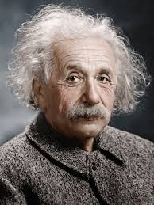

SOME QUIPS BEFORE WE START
The grand aim of all science is to cover the greatest number of empirical facts
by logical deduction
from the smallest number of hypotheses or axioms
– Albert Einstein
Everyone you will ever meet knows something you don’t.
Respect their knowledge and learn from them. It will bring out the best in all of you.
– Bill Nye

Slide 4
Agenda
About me
What is analytics?
About the topic
From data to decisions – gaps and possible solutions
Analytics Continuum / Conundrum
Descriptive Analytics
Predictive Analytics
Prescriptive Analytics
A walk up the continuum with examples
Key takeaways
References and links

Slide 5
About me
14+ years of experience building analytics solutions primarily in Semiconductor Manufacturing and Supply Chain Management
Currently leading a small team that does “Decision Engineering”
Primary focus
Simulation in Operations Research => Descriptive Analytics!
Machine Learning / Data Science => Predictive Analytics!
Mathematical Optimization (Linear Programming) Algorithms => Prescriptive Analytics!
Metaheuristics (nature-inspired) Algorithms => Prescriptive Analytics!
Interests
Internet of things (hacked around a bit) – Neurocognitive IoT, Smart Homes
Computer Vision – CNNs for object / character recognition
Competitive problem solving – Operations Research (www.puzzlor.com, https://careers.3ds.com/puzzle-quintiq) & Machine Learning (www.kaggle.com)

Slide 6
TERMS DEMYSTIFIED
Data Analysis | Data Analytics | Data Science
The process of collection, manipulation, transformation, arrangement and examination of data. Can be broken down into: Gathering data Manipulate and transform the data into comprehensible formats Separating data into component parts Data exploration & evaluation Examining the data for insights | A broader term that includes data analysis as necessary subcomponent. Analytics defines the science behind the analysis. The science means understanding the cognitive processes (the mechanics or algorithms) an analyst uses to understand problems and explore data in meaningful ways to derive insights. Analytics also includes data extract, transform, and load; specific tools, techniques, and methods; and how to successfully communicate results. | A combination of mathematics, statistics, programming, the context of the problem being solved, ingenious ways of capturing data and extraction of valuable knowledge / information from data. It is geared toward helping individuals and organizations make better decisions from stored, consumed and managed data. Data science was formerly known as datalogy.
Analysis is separating out a whole entity into parts, study the parts individually and their relationships with one another | Analytics is the principle or logic that drives the analysis | Science is the systematic knowledge of a system gained through observation and experimentation using stipulated methods or techniques

Slide 7
THE TOPIC – FROM DATA TO DECISIONS #1/3
Decision / Management Science – how do I answer these questions?
Who will be my customers and how many?
What will be my demand for the next year (and beyond)?
What should be my product(s) lines?
How many facilities should I open and where?
For supply chains -
What transportation option should I use?
How should I trade-off service and cost?
Where should I source my raw material from?
How much inventory should I have?
We have abundant historical data, a plethora of techniques, algorithms, research and latest developments; still unable to answer the above questions “confidently”

Slide 8






THE TOPIC – FROM DATA TO DECISIONS #2/3
Reasons for this decision gap?
Models and algorithms are mostly blackbox – specifically neural networks and complex ensemble models. Unexplainable predictions or un-interpretable results
Causal inference – Models are usually based on correlation. Correlation does not imply causation. For business decisions, I need “cause & effect”; read as Sensitivity Analysis (SA)
Magnitude of uncertainty – I added regularization, dropouts, etc., but did my model generalize well for actual scenarios? Point decisions are arrived at either using Maximum Likelihood Estimates (MLE) or optimizing a cost function
External factors – Models mostly account for known, linear, direct interactions
Not comprehending all restraints – Most business decisions are made under cost, time and effort restraints. Models don’t account for these unknowns
Algorithms
Data
Business Decisions
Techniques
Significant gap
LINKS
MLE - https://medium.com/@rrfd/what-is-maximum-likelihood-estimation-examples-in-python-791153818030
SA - http://dpannell.fnas.uwa.edu.au/dpap971f.htm

Slide 9
THE TOPIC – FROM DATA TO DECISIONS #3/3
What are the smart engineers/scientists doing to bridge the gap?
Model interpretability
Local Interpretable Model-Agnostic Explanations (LIME) - https://www.oreilly.com/learning/introduction-to-local-interpretable-model-agnostic-explanations-lime
Interpretable machine learning - https://christophm.github.io/interpretable-ml-book/
Deep Learning Feature Visualization - https://distill.pub/2017/feature-visualization/
Shapley Values - https://towardsdatascience.com/one-feature-attribution-method-to-supposedly-rule-them-all-shapley-values-f3e04534983d
Causal inference
Causal Machine Learning - https://www.youtube.com/watch?v=rkpNZ6Sf7NM ; http://www.unofficialgoogledatascience.com/2017/01/causality-in-machine-learning.html
Bayes Nets - https://www.youtube.com/watch?v=gMQZq2O8yDA; https://inst.eecs.berkeley.edu/~cs188/fa18/assets/slides/lec15/FA18_cs188_lecture15_bayes_nets_III_inference_1pp.pdf
Structural Equation Modeling - https://www.youtube.com/watch?v=eKkESdyMG9w ; https://www.kdnuggets.com/2017/03/structural-equation-modeling.html
Magnitude of uncertainty
Quantification of uncertainty - https://en.wikipedia.org/wiki/Uncertainty_quantification
Probabilistic programming/Bayesian Inference - http://jakevdp.github.io/blog/2014/03/11/frequentism-and-bayesianism-a-practical-intro/
External factors
Reinforcement Learning techniques like Q-Learning helps in learning the environment / ecosystem.
Not comprehending all restraints
Constrained Optimization to the rescue

Slide 10
The GAP STILL EXISTS! WHAT IS THE SOLUTION? THAT IS OUR TOPIC FOR TODAY

Slide 11
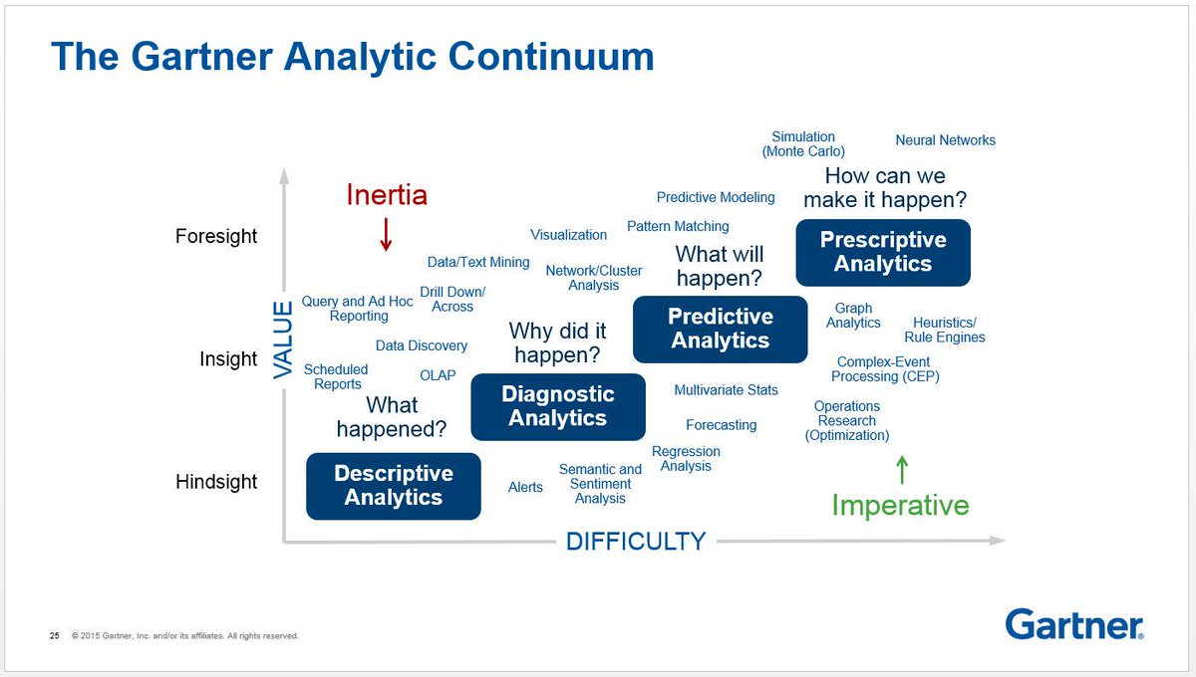
THE ANALYTICS CONTINUUM #1/4

Slide 12
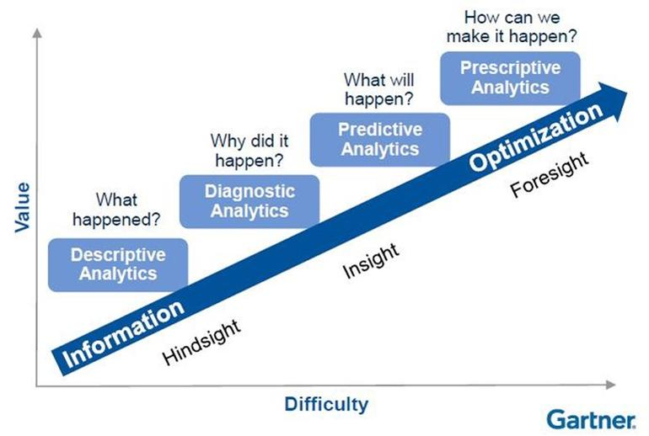
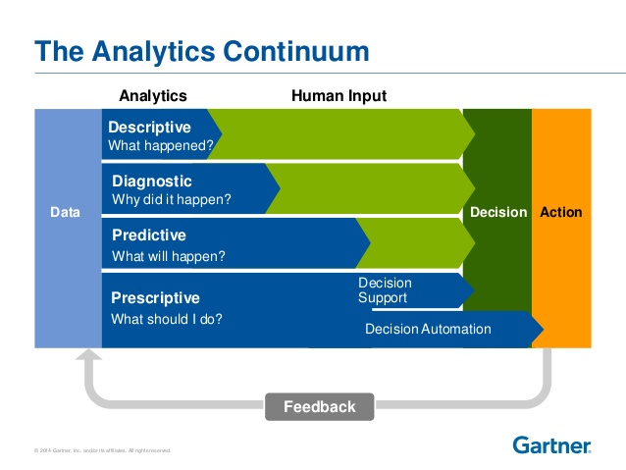
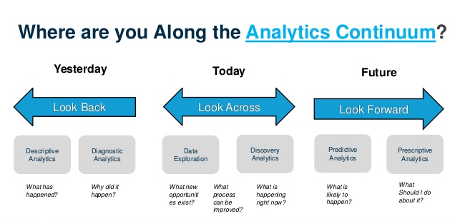
THE ANALYTICS CONTINUUM #2/4

Slide 13
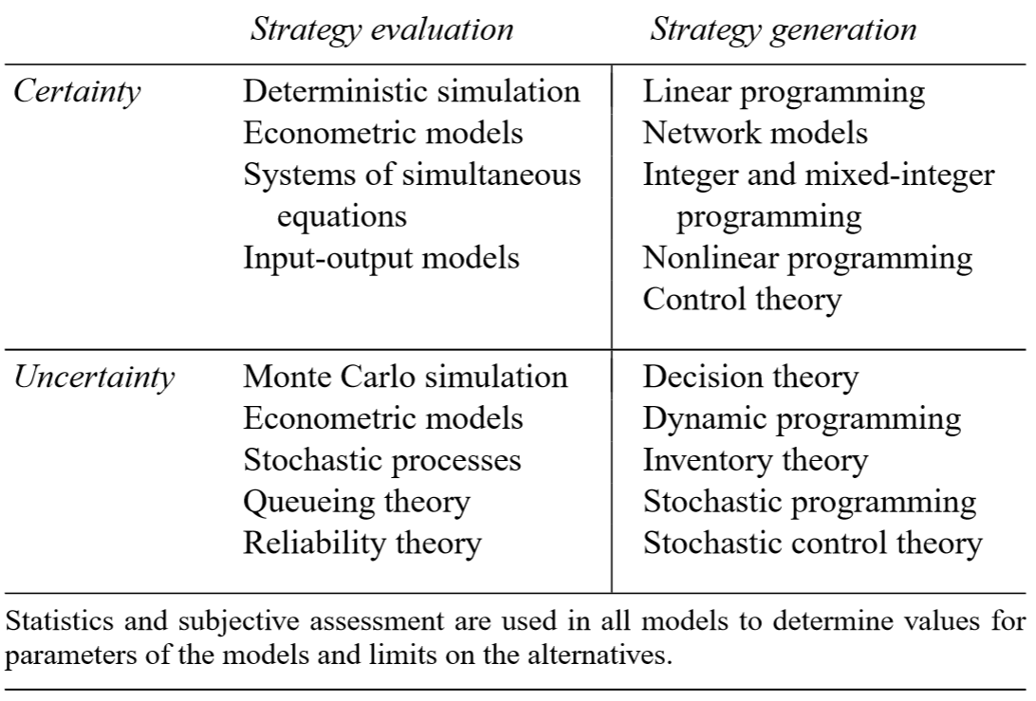
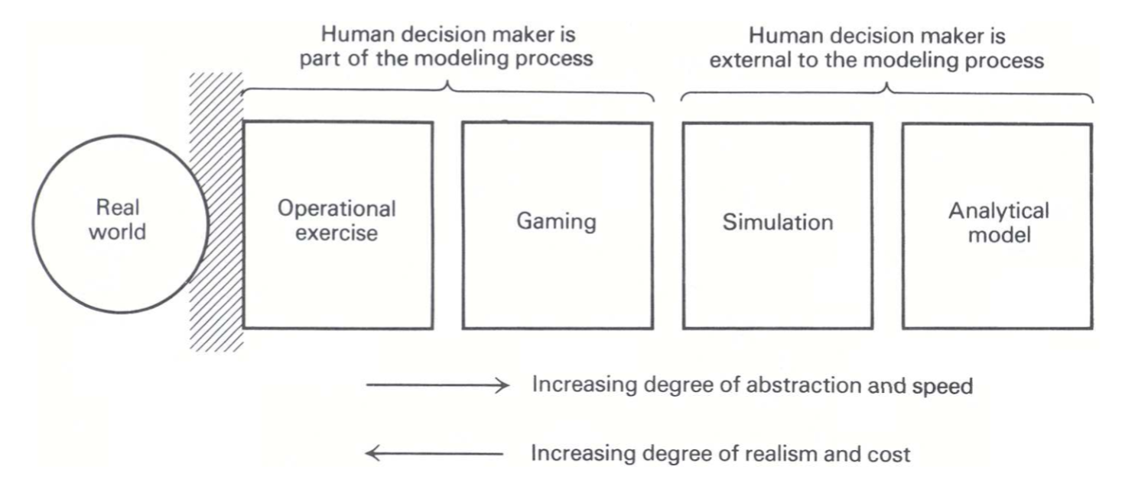
THE ANALYTICS CONTINUUM – LOOK BACK #3/4
CLASSIFICATION OF MODELS
SOURCE: Applied Mathematical Programming by Bradley, Hax, and Magnanti, 1977 LINK: http://web.mit.edu/15.053/www/AMP.htm

Slide 14
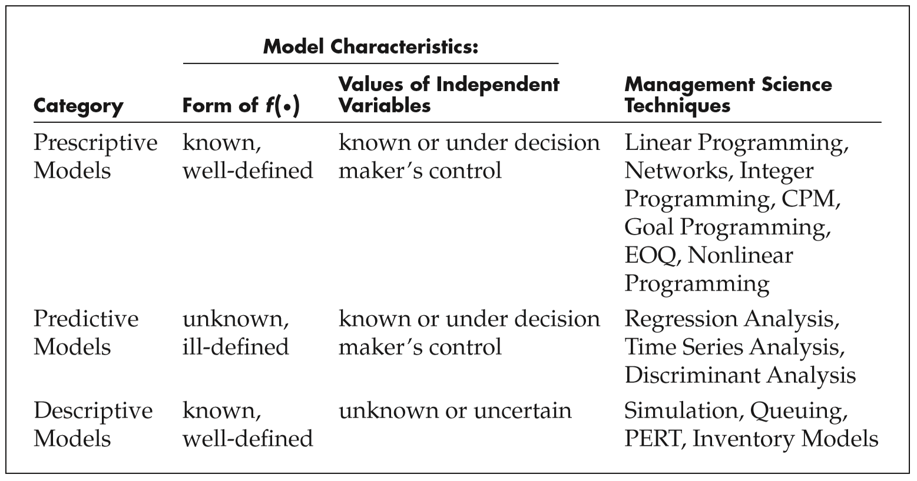
THE ANALYTICS CONTINUUM – LOOK BACK #4/4
Descriptive models start with data. They may not give any decisions at all
Prescriptive models start with functions/algorithms. They “may” depict the expected decisions, but what about data?
SOURCE: SPREADSHEET MODELING AND DECISION ANALYSIS by CLIFF T. RAGSDALE, 6th EDITION, 2010

Slide 15
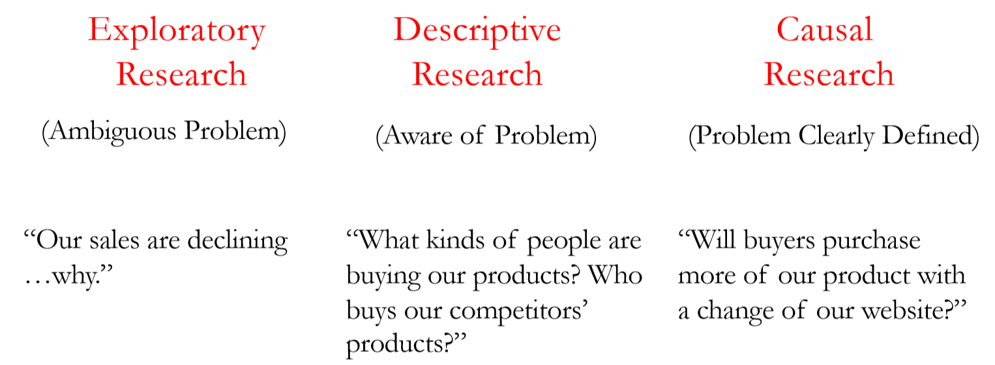
DESCRIPTIVE ANALYTICS – WHAT IS IT?
Information needed for actionable decisions
Principles for systematically collecting and interpreting data that can aid decision makers
SOURCE: BUSINESS ANALYTICS, WHARTON BUSINESS SCHOOL

Slide 16
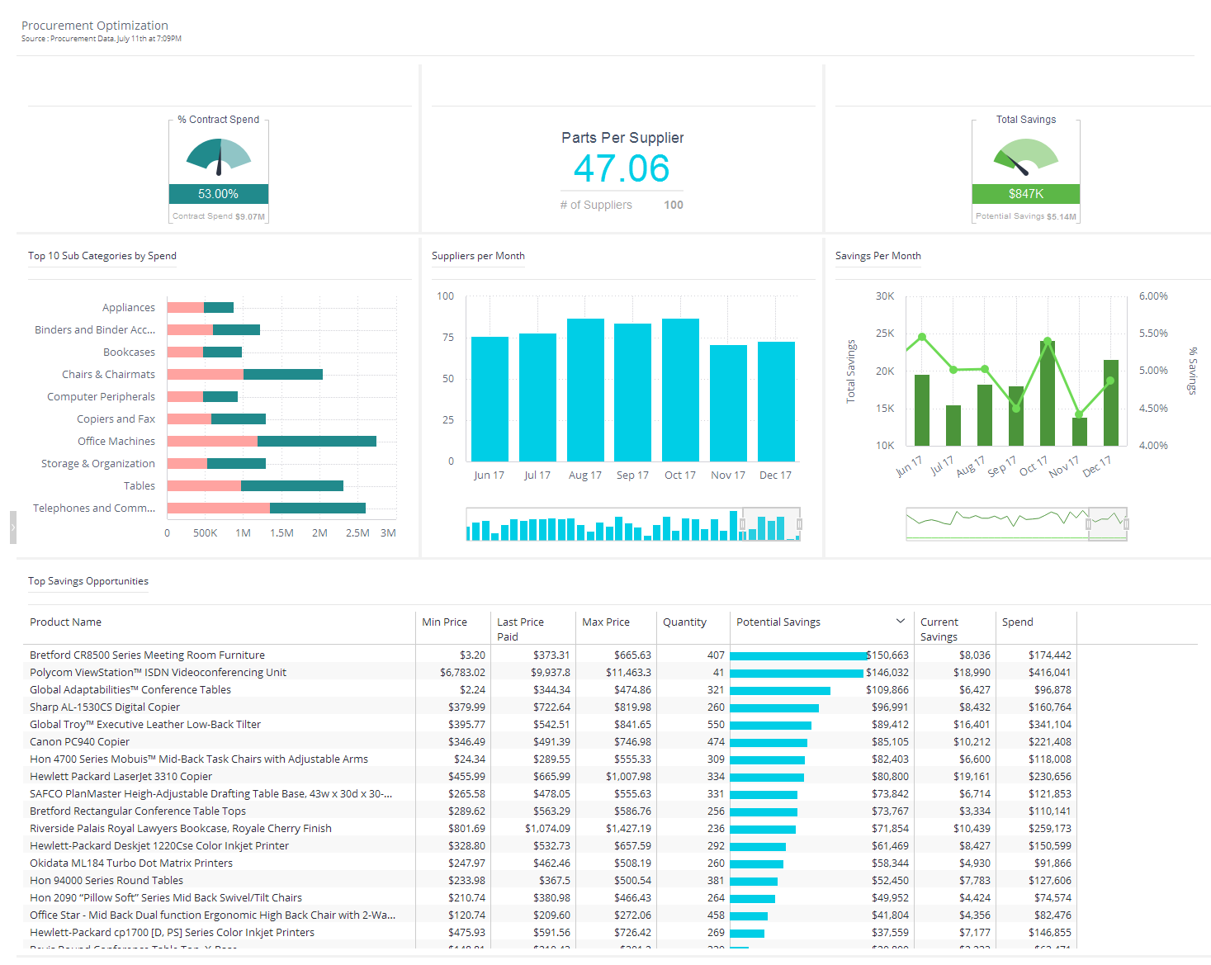
DESCRIPTIVE ANALYTICS – INDUSTRY EXAMPLE #1

Slide 17
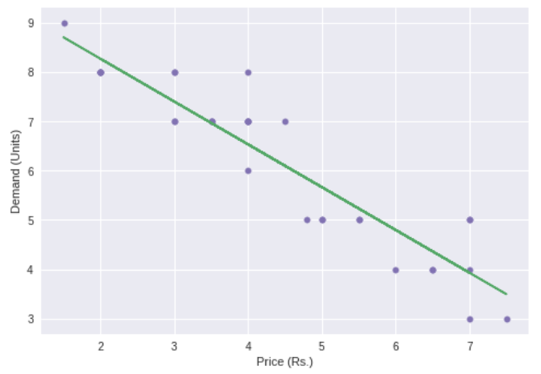
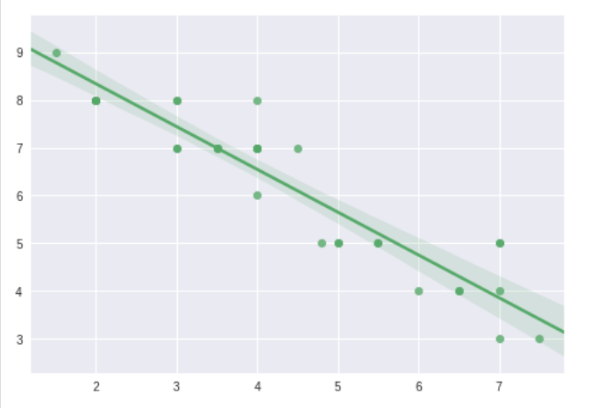
DESCRIPTIVE ANALYTICS – EXAMPLE FROM SCRATCH
Price (₹) | Demand (Units)
4.0 | 7
3.5 | 7
5.0 | 5
6.0 | 4
6.5 | 4
7.0 | 4
2.0 | 8
4.0 | 6
5.5 | 5
3.0 | 7
3.5 | 7
2.0 | 8
2.0 | 8
3.0 | 8
3.0 | 7
1.5 | 9
3.0 | 8
4.8 | 5
5.0 | 5
4.0 | 7
4.5 | 7
4.0 | 8
7.5 | 3
4.0 | 7
6.5 | 4
4.0 | 7
7.0 | 3
5.5 | 5
7.0 | 5
3.5 | 7
7.0 | 5
2.0 | 8
A simple data set with price as an independent variable and demand as a dependent variable
Estimated coefficients:
b_0 = 10.004799510742398
b_1 = -0.867568070623272
Price |  | Demand
Mean | 4.4 | Mean | 6.1875
Standard Error | 0.307860725 | Standard Error | 0.295932
Median | 4 | Median | 7
Mode | 4 | Mode | 7
Standard Deviation | 1.741523249 | Standard Deviation | 1.674043
Sample Variance | 3.032903226 | Sample Variance | 2.802419
Kurtosis | -0.99506987 | Kurtosis | -1.04812
Skewness | 0.212632356 | Skewness | -0.35996
Range | 6 | Range | 6
Minimum | 1.5 | Minimum | 3
Maximum | 7.5 | Maximum | 9
Sum | 140.8 | Sum | 198
Count | 32 | Count | 32

Slide 18
DESCRIPTIVE ANALYTICS – ENTER SIMULATION
A simulation is an imitation of the operation of a real-world process or system.^{[1]} The act of simulating something first requires that a model be developed; this model represents the key characteristics, behaviors and functions of the selected physical or abstract system or process. The model represents the system itself, whereas the simulation represents the operation of the system over time. Source: Wikipedia
I came across a very powerful tool from a company called Anylogic. You can get a Personal Learning Edition (PLE) installed on any computer for free. https://www.anylogic.com/downloads/personal-learning-edition-download/ . Some examples below:
1) Bank ATM / Cashier example -
https://cloud.anylogic.com/assets/embed?modelId=7fb3e1d9-acc8-4b91-b674-47f325408a64
2) Baggage Claim in an airport –
https://cloud.anylogic.com/assets/embed?modelId=5e8ff5b8-6ade-46d8-a26a-50729d1780d7
A manufacturing job shop factory –
https://cloud.anylogic.com/assets/embed?modelId=8a1fecf4-6f48-4461-96c1-a0d5a1327cda
Industries use simulation mostly to see how systems or real processes would behave over time. We could also use simulation to quantify the uncertainty in a system – example Monte Carlo simulation

Slide 19
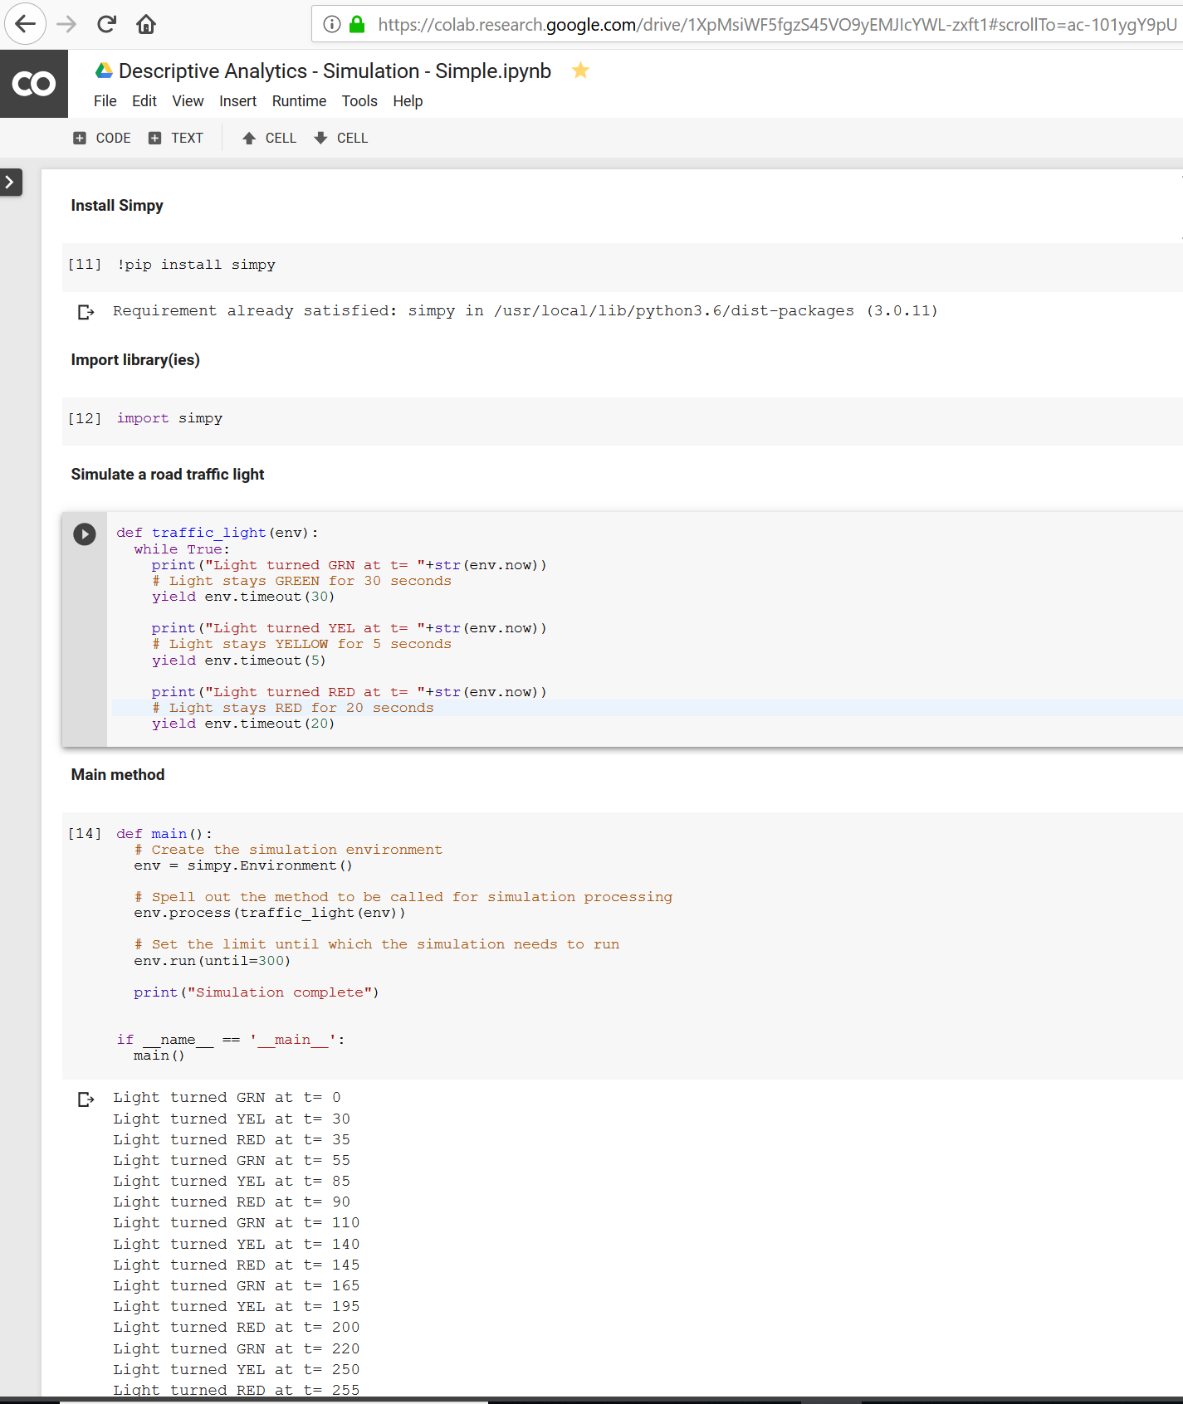
DESCRIPTIVE ANALYTICS – SIMULATION with PYTHON SIMPY
We can see how the system would behave over time even though we have a faint idea ahead of time. In the below example I have simulated a traffic signal for 5 minutes
As you can see – within 2 seconds I can see what is going to happen over the next 5 minutes – “based on historical information”. This is very powerful to understand the system better.
In the process, I can generate data which is not otherwise available. This is data augmentation which is a key subject when enough data is not available

Slide 20
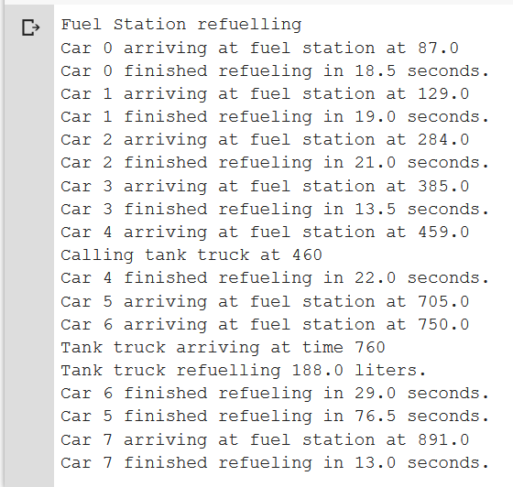
DESCRIPTIVE ANALYTICS – SIMULATION ADVANCED EXAMPLE
A fuel station has a limited number of fuel pumps that share a common fuel reservoir. Cars randomly arrive at the fuel station, request one of the fuel pumps and start refueling from that reservoir. A fuel station control process observes the fuel station's fuel level and calls a tank truck for refueling if the station's level drops below a threshold
ADAPTED FROM SIMPY DOCUMENTATION: https://simpy.readthedocs.io/en/3.0.11/examples/gas_station_refuel.html

Slide 21
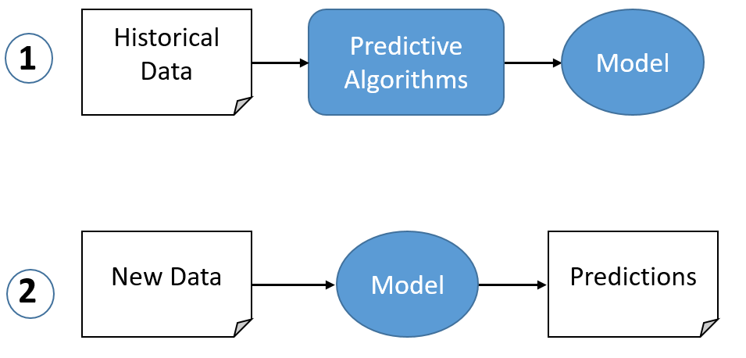
PREDICTIVE ANALYTICS – DEFINITION & EXAMPLES
Predictive analytics encompasses a variety of statistical and mathematical techniques that analyze current and historical data/facts to make predictions about future or otherwise unknown events. In business, predictive models exploit patterns found in historical and transactional data to identify risks and opportunities. Models capture relationships among many factors to allow assessment of risk or potential associated with a particular set of conditions, guiding decision making. The model is then applied to current data to predict what will happen next. At its heart, predictive analytics answers the question, “What is most likely to happen based on my current data?”
Which product the customer is likely to buy in his next purchase ? (recommender system)
Which customer is likely to default in his/her loan payment ? (credit risk)
Who is likely to cancel the product that was ordered through e-commerce portal ? (Logistics cost savings)
Which warehouse will run out of capacity in the next quarter? (Supply Chain)
What would be my product demand in the next month? (Manufacturing)

Slide 22
PREDICTIVE ANALYTICS – WORKED OUT EXAMPLE
Predicting Future Temperatures
The problem we will tackle is predicting the max temperature for tomorrow in our city using one year of past weather data. We are going to act as if we don’t have access to any weather forecasts. What we do have access to is one year of historical max temperatures, the temperatures for the previous two days, and an estimate from a friend who is always claiming to know everything about the weather.
This is a supervised, regression problem. It’s supervised because we have both the features (data for the city) and the targets (temperature) that we want to predict.
We will use the Random Forest Regression technique for this problem. During training, we give the random forest both the features and targets and it must learn how to map the data to a prediction.

Slide 23
PRESCRIPTIVE ANALYTICS – DEFINITION & EXAMPLES
Prescriptive analytics is referred to as the "final frontier of analytic capabilities,“ prescriptive analytics entails the application of mathematical and computational sciences. Prescriptive analytics not only anticipates what will happen and when it will happen, but also why it will happen. Further, prescriptive analytics suggests decision options (answers questions like “what should I do next”) on how to take advantage of a future opportunity or mitigate a future risk and shows the implication of each decision option. Prescriptive analytics can continually take in new data to re-predict and re-prescribe, thus automatically improving prediction accuracy and prescribing better decision options. Prescriptive analytics ingests hybrid data, a combination of structured (numbers, categories) and unstructured data (videos, images, sounds, texts), and business rules to predict what lies ahead and to prescribe how to take advantage of this predicted future without compromising other priorities. It encompasses the following:
Define the problem
Define the Objectives and Goals
Optimization – how to find the best action to take
Examples:
How many units of inventory should I release from an inline store or warehouse in my factory? (Manufacturing)
How many trucks or air carriers should I subscribe to for maintaining customer service levels (Supply Chain Logistics)
A recommender system suggesting the most optimal recommendations for you based on your constraints (Retail)

Slide 24
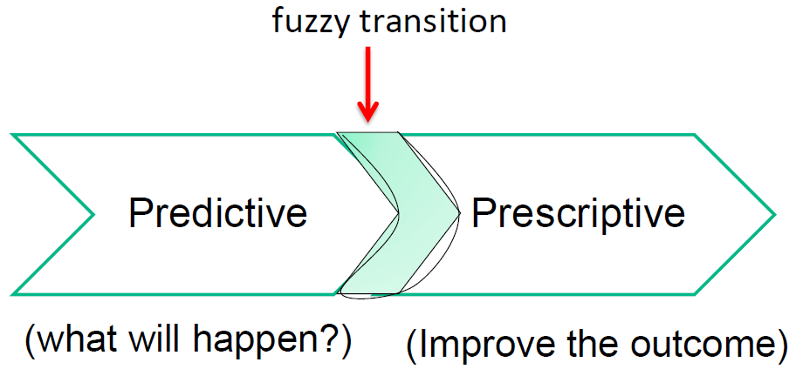
PRESCRIPTIVE ANALYTICS - More thoughts & EXAMPLES
Price optimization: A particularly good example is airline ticket pricing. Especially in the case of airline pricing, the best solutions are those that can occur in near real time. The addition of the time constraint however does not differentiate predictive from prescriptive
Optimizing parcel delivery routes and schedules
Mechanical preventive maintenance: The optimization here is the tradeoff between leaving the device in service (presumably revenue generating) and proactively removing it from service prior to breakdown (presumably reducing repair cost and time).
Staffing optimization: This is a hot topic for hospitals and other health care providers but could equally apply to the factory floor or service industries.

Slide 25
PRESCRIPTIVE ANALYTICS – WORKED OUT EXAMPLE
The Department of Applied Mathematics and Computational Sciences (DAMCS) is planning a day long Login trip for 400 students. The company providing the transportation has 10 buses of 50 seats each and 8 buses of 40 seats, but only has 9 drivers available. The rental cost for a large bus is Rs. 800 and Rs. 600 for the small bus. Calculate how many buses of each type should be used for the trip with the least possible cost

Slide 26
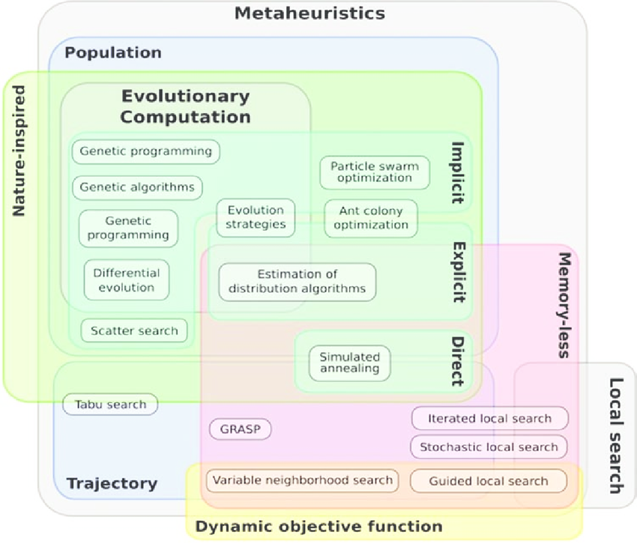
PRESCRIPTIVE ANALYTICS – METAHEURISTICS
A metaheuristic is a procedure designed to find, generate, or select a heuristic (partial search algorithm) that may provide a sufficiently good solution to an optimization problem, especially with incomplete or imperfect information or limited computation capacity.

Slide 27
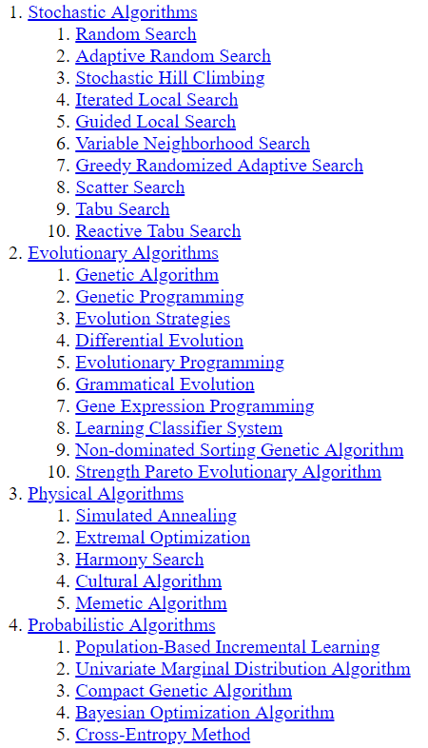
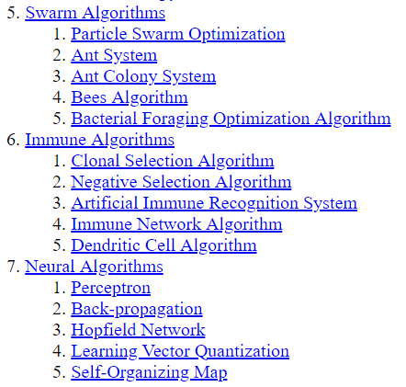
PRESCRIPTIVE ANALYTICS – METAHEURISTICS

Slide 28
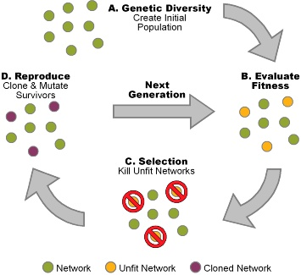
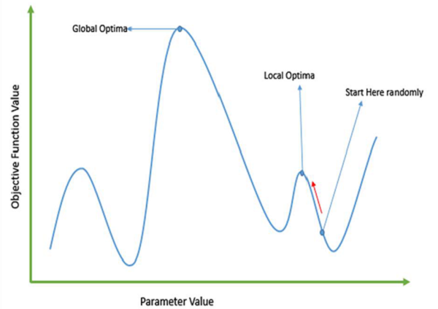
PRESCRIPTIVE ANALYTICS – Genetic ALGORITHM WORKED EXAMPLE

Slide 29
A CAREFUL WALK UP THE ANALYTICS CONTINUUM CAN GIVE YOU “WHAT DECISION” YOU NEED TO TAKE AND “WHEN” FOR YOUR BUSINESS’ COMPETITIVE ADVANTAGE
KEY TAKEAWAY FROM THE TALK

Slide 30
KEY POINTERS FOR YOU
Stick to the basics. Follow your lecturers/professors
Maths, algorithms, programming, stats - focus and spend a lot of time. Practise and solve a lot of problems of your own.
Pick one programming language and stick to it. But know in and out of it. Internals of how it works, memory management, etc.,
Take up one idea. Make that one idea your life - think of it, dream of it, live on that idea. Let the brain, muscles, nerves, every part of your body, be full of that idea, and just leave every other idea alone. This is the way to success - Swami Vivekananda

Slide 31
CONTACT
Email: abalki@gmail.com
Whatsapp: 9886090148
This presentation and python notebooks available at:
https://bit.ly/2rrxMSN or directly my github:
https://github.com/abalki/PSGTech-TechTalk
LinkedIn: www.linkedin.com/in/abalki

Slide 32
BACKUP

Slide 33
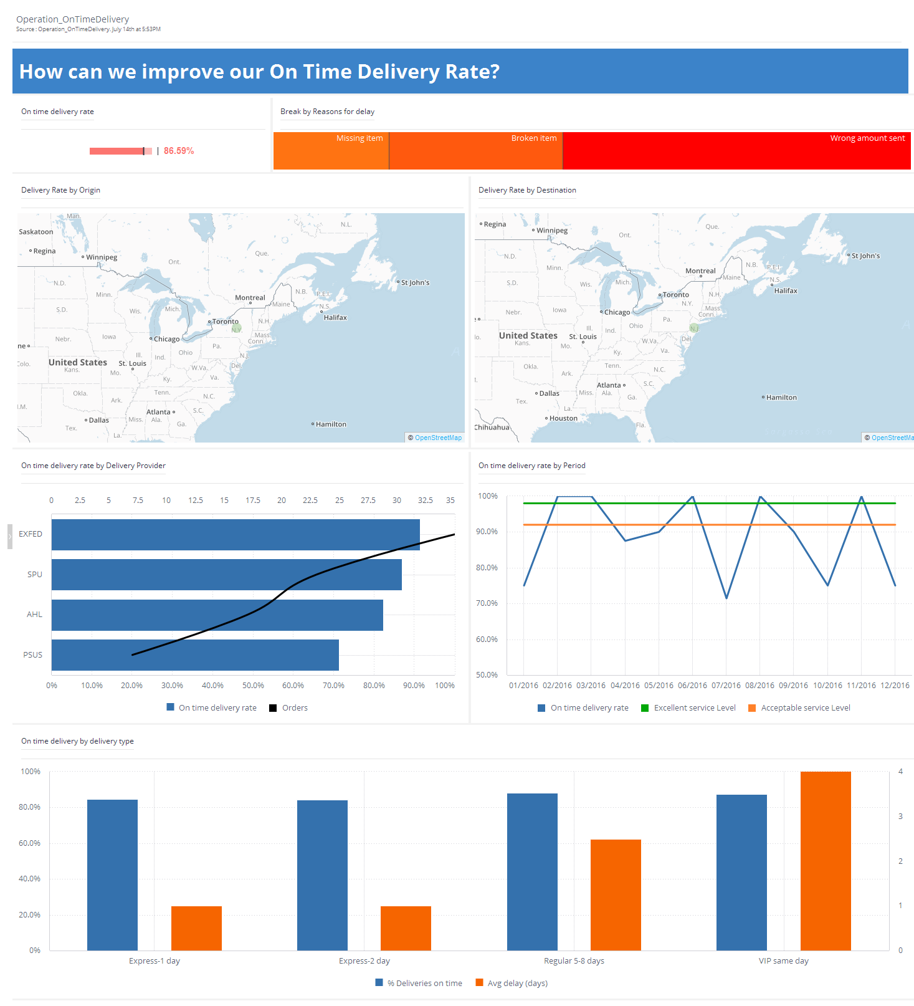
DESCRIPTIVE ANALYTICS – INDUSTRY EXAMPLE #2

Slide 34
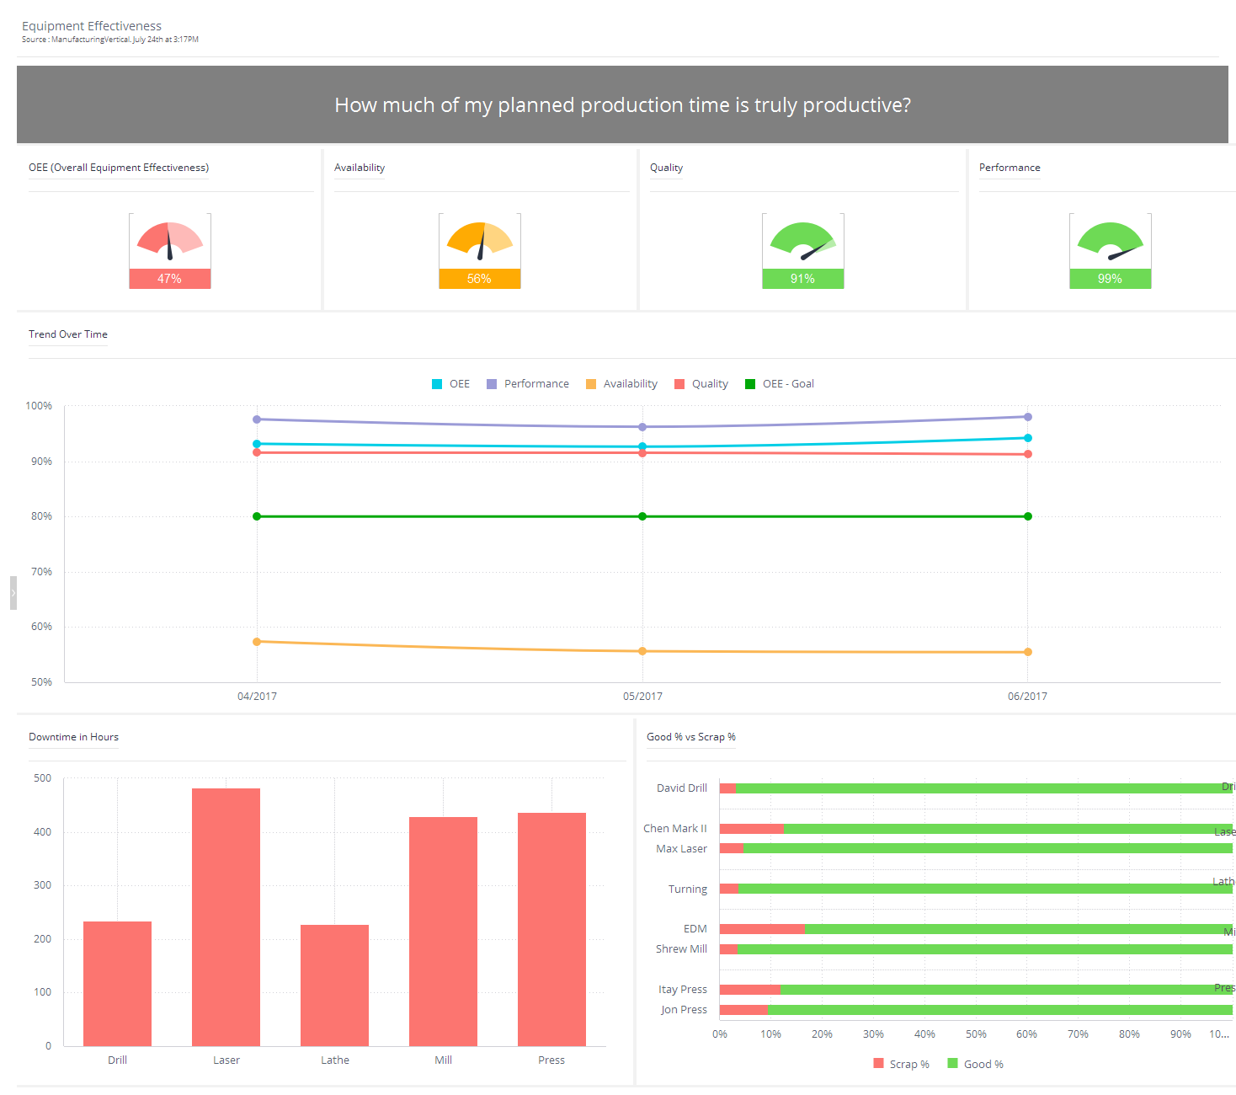
DESCRIPTIVE ANALYTICS – INDUSTRY EXAMPLE #3

Slide 35
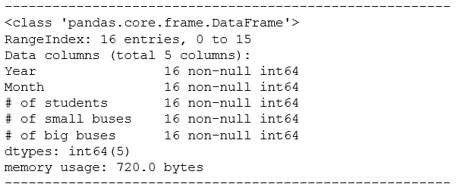
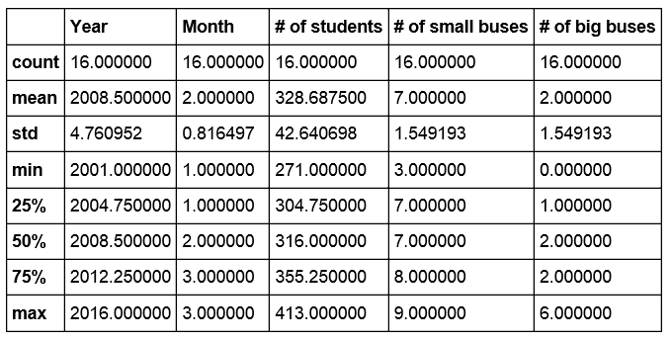
Descriptive – Descriptive Statistics
 | Year | Month | # of students | # of small buses | # of big buses
0 | 2001 | 2 | 284 | 7 | 2
1 | 2002 | 3 | 277 | 7 | 2
2 | 2003 | 2 | 317 | 8 | 1
3 | 2004 | 3 | 313 | 9 | 0
4 | 2005 | 1 | 318 | 8 | 1
5 | 2006 | 2 | 374 | 6 | 3
6 | 2007 | 1 | 413 | 3 | 6
7 | 2008 | 3 | 405 | 4 | 5
8 | 2009 | 1 | 355 | 8 | 1
9 | 2010 | 1 | 306 | 7 | 2
10 | 2011 | 2 | 271 | 7 | 2
11 | 2012 | 2 | 306 | 8 | 1
12 | 2013 | 3 | 315 | 8 | 1
13 | 2014 | 3 | 301 | 8 | 1
14 | 2015 | 2 | 356 | 7 | 2
15 | 2016 | 1 | 348 | 7 | 2

Slide 36
PRESCRIPTIVE - Problem 1: Product mix problem
A telephone company processes and sells two kinds of products:
Desk phones
Cellular phones
Each type of phone is assembled and painted by the company, which wants to produce
at least 100 units of each product.
A desk phone's processing time is:
12 min. on the assembly machine and
30 min. on the painting machine
•
A cellular phone's processing time is:
24 min. on the assembly machine and
24 min. on the painting machine
• The assembly machine is available for only 400 hours.
• The painting machine is available for only 490 hours.
• Desk phones return a profit of $12 per unit.
• Cellular phones return a profit of $20 per unit.
The objective is to maximize profit.

Slide 37
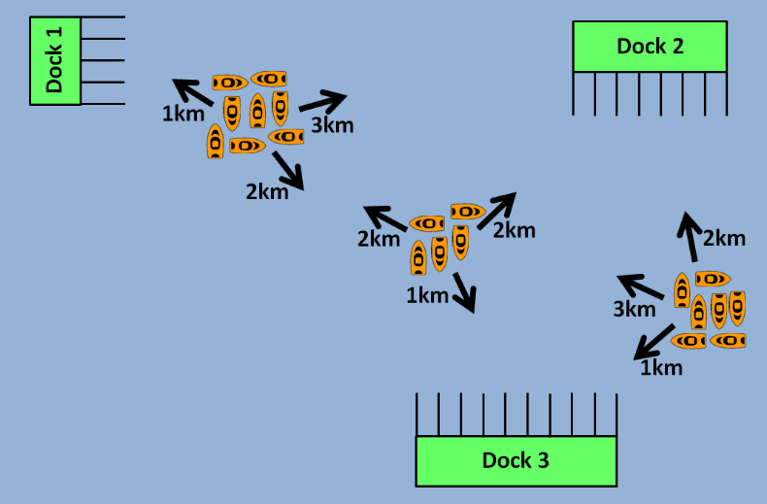
PRESCRIPTIVE - Problem 2: Any port in a storm
There is significant danger to boats caught out in the open sea during a storm. Ideally, boats will dock before the storm hits and wait it out.
The map below shows 20 orange boats out at sea. With a storm approaching, each boat needs to be directed to one of three docks. Docks have a limited number of spaces available for boats (indicated by the rectangular spaces). Altogether, there are 20 boat spaces available. The boats are clustered into three areas and each area varies in distance to the docks (indicated by black arrows). All boats must be assigned to 1 space in a dock.
What is the minimum possible total distance traveled by all boats? http://puzzlor.com

Slide 38
